Slide 1
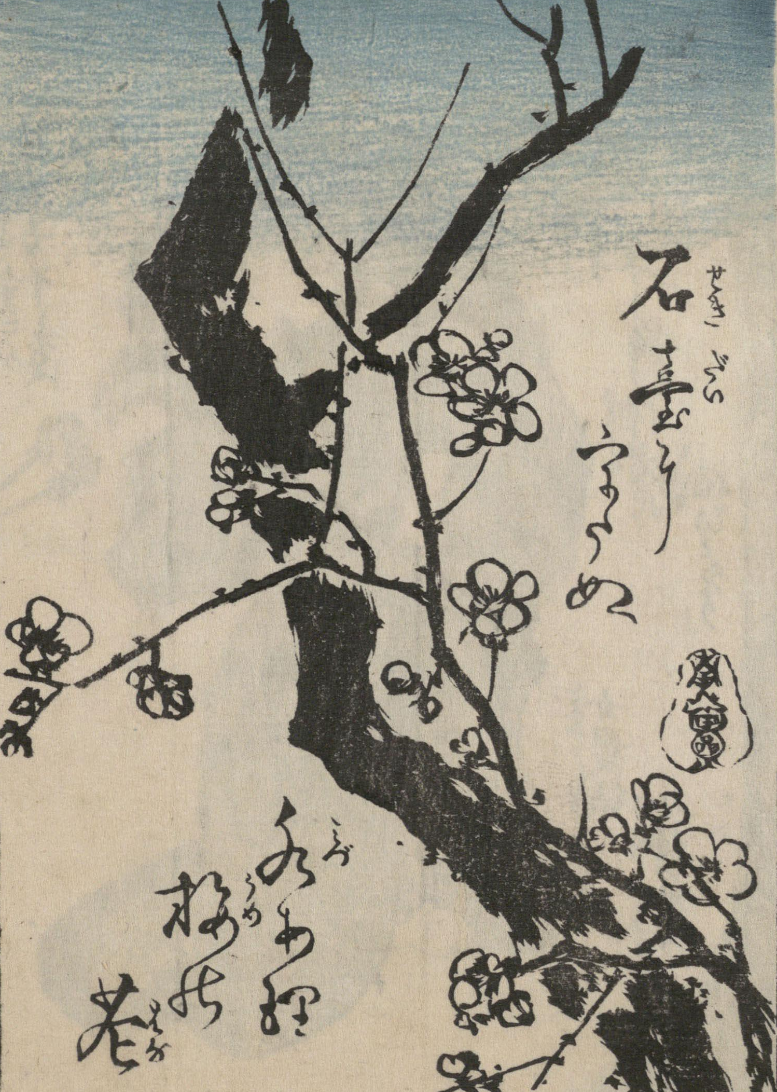

Kuzushiji Recognition
くずし字認識
Deanna Thomas

Slide 2
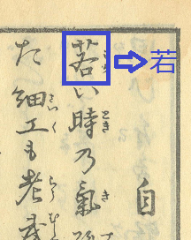
What is Kuzushiji?
Kuzushiji is a “cursive” style of writing used in Japan up until around 1900 when it stopped being used or taught in schools.
Only about 0.01% of the Japanese population can read Kuzushiji
An example of translating Kuzushiji to modern script

Slide 3
Project Goals
I split this challenge up into three goals:
Use an artificial neural network to classify the characters only
Use a convolutional neural network to classify the characters only
(Stretch Goal) Use a convolutional neural network to identify the characters on the page and classify the characters, as per the original challenge.

Slide 4
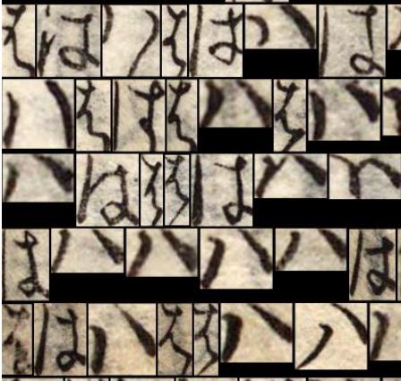
Data Challenges
Script written in 3 different alphabets, for a total of 4,212 distinct labels
Some pages seem to be written on very thin paper, showing bleed from other pages
The pages and characters themselves were different sizes
The characters were written in multiple different ways
Characters can overlap each other
Character frequencies vary immensely
Different ways the characters は and ハ are written

Slide 5
Training Data
3500 individual pages of Kuzushiji script
On average, about 120 characters per page
Total of 683,464 lines of data

Slide 6
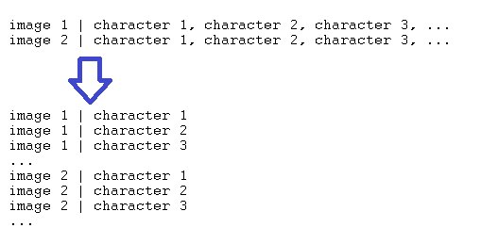
Preparing the Data
For goals 1 and 2, I need to separate each character into a new line of data

Slide 7
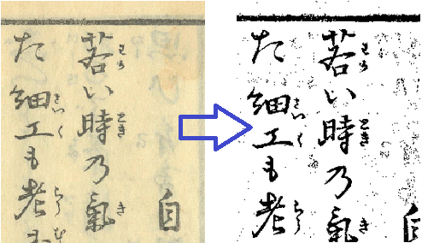
Preparing the Data
For goals 1 and 2, I need to separate each character into a new line of data
Threshold the images to remove background color and page bleed

Slide 8
Simplifying the Data
To create a data set that is more manageable to work with, I simplified the data by creating separate files for each alphabet.
all_katakana.csv – 30 x 30 images of Katakana alphabet only (about 18k lines, 80 labels)
all_hiragana.csv – 30 x 30 images of Hiragana alphabet only (about 430k lines, 82 labels)
all_kanji.csv – 30 x 30 images of Kanji alphabet only (about 234k lines, 4050 labels)

Slide 9
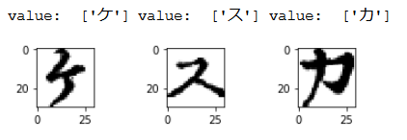
Goal 1: Artificial Neural Network
To convert to usable data for an ANN:
Divide pixel values by 255 for a normalized float
Map each character to an arbitrary integer value
ケ-> 1, ス -> 2, カ-> 3, …
Used np_utils.to_categorical to create a label vector
Sample character images

Slide 10
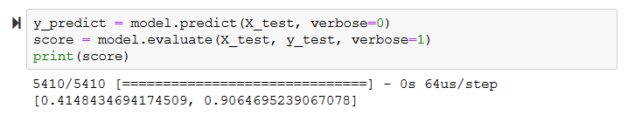
Goal 1: Artificial Neural Network
Next, I test the size of the ANN (Recall: 18k rows of data, 900 columns, 80 labels for this subset)
1 layer ANN with neurons from 100 – 900 in multiples of 10
2 layer ANN with neurons in both layers ranging from 100 – 900 in multiples of 50
Best network size was 1 layer with 630 neurons where accuracy was 90.65%

Slide 11
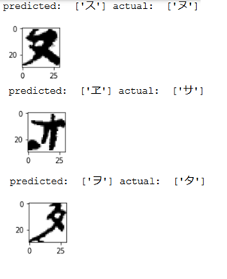
Goal 1: Artificial Neural Network
To verify the results, I ran a loop to check which characters were misclassified.
Many characters seemed to be misclassified because they are rare in the language

Slide 12
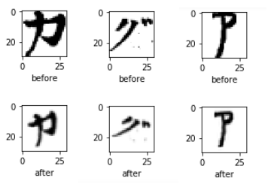
Goal 1: Artificial Neural Network
To even out the character counts, I wrote an algorithm to duplicate data until it has a minimum of 25 entries
Resize the character +-10%
Randomly reposition it in the frame
Rotate the character +- 10 degrees
Added about 4000 lines of data

Slide 13
Goal 1: Artificial Neural Network
After duplicating less frequent data, I re-trained the ANN
Accuracy improved less than 1%
When verifying mistakes, less rare characters were seen

Slide 14
Goal 1: Artificial Neural Network
After completing this process using the Katakana alphabet dataset, I applied the knowledge I had to the other datasets, as well as the complete dataset.
ANN
One layer, 630 neurons
No duplicated data (due to long running times and negligible improvement)

Slide 15
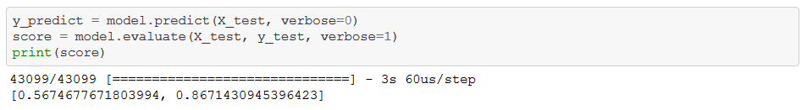
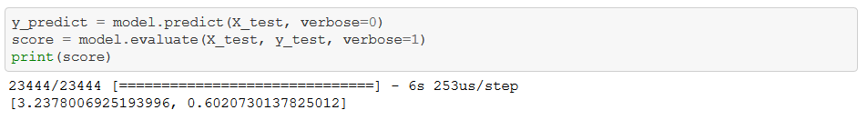
Goal 1: Artificial Neural Network
Hiragana Alphabet (430k rows, 900 columns, 82 labels): 86.71% accuracy
Kanji Alphabet (234k rows, 900 columns, 4050 labels): 60.21% accuracy

Slide 16
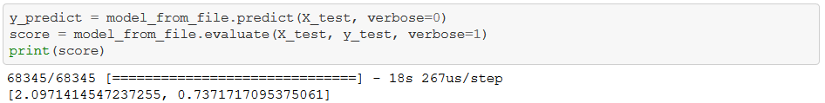
Goal 1: Artificial Neural Network
Complete data set (668k rows, 900 columns, 4212 labels): 73.72% accuracy

Slide 17
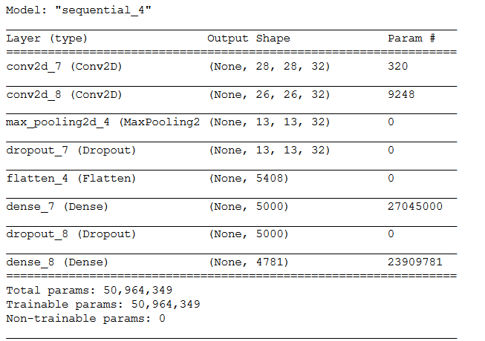
Goal 2: Convolutional Neural Network
CNN is much more suited to classifying images than an ANN
Created a two-layer CNN (see right)
Tested with entire dataset

Slide 18
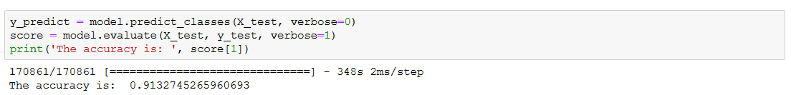
Goal 2: Convolutional Neural Network
In only 6 epochs, the CNN achieved a 91% accuracy

Slide 19
Goal 3: Identify and Classify
I did not complete my stretch goal to identify and then classify the characters
Significant work would be needed to accurately detect the characters on the page, both for machine resources and to design a model; wasn’t able to complete

Slide 20
References
Kaggle challenge: https://www.kaggle.com/c/kuzushiji-recognition/
My code on GitHub: https://github.com/deannacodes/kuzushiji_recognition

